Slide 1
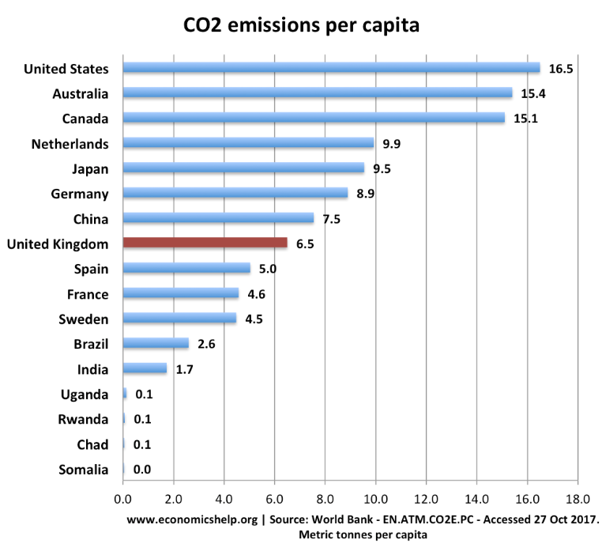
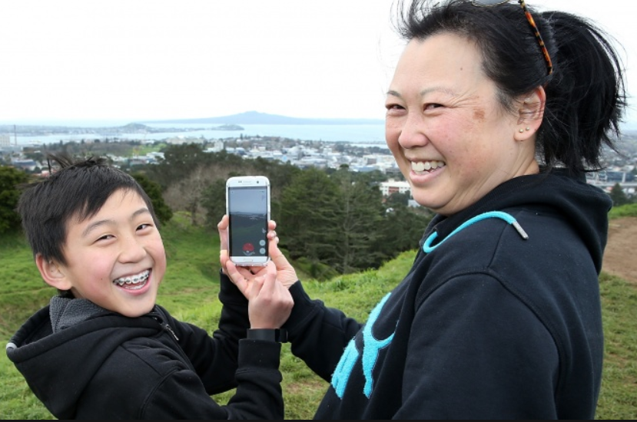
green Zorro helps you to reduce your CO2 footprint!
3TONS!!! We made it!
Notes:
The ratings relate to the fact that for an individual to live sustainably the amount of CO2 they are allowed to emit is approx. 3Tons/year.
The value relating to the amount of CO2 that the earth can consume without accumulating CO2 in the atmosphere.
For each category an individual page is dedicated explaining why and how emission values are achieved Prior commencing the game.
The individuals Carbon footprint should be evaluated for the past year.
The gaming app is based on individual cabon footprin, but can could be developed to community, company or country level.

Slide 2
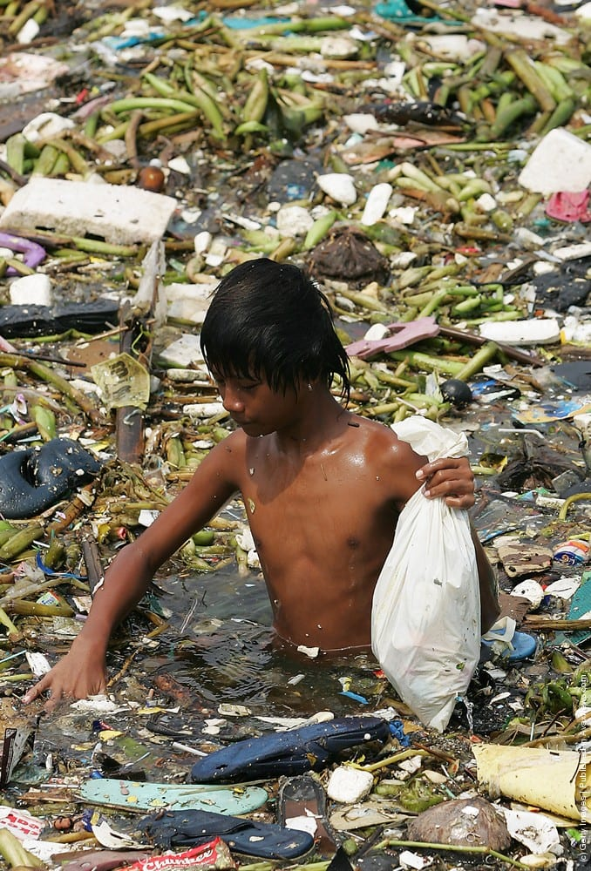
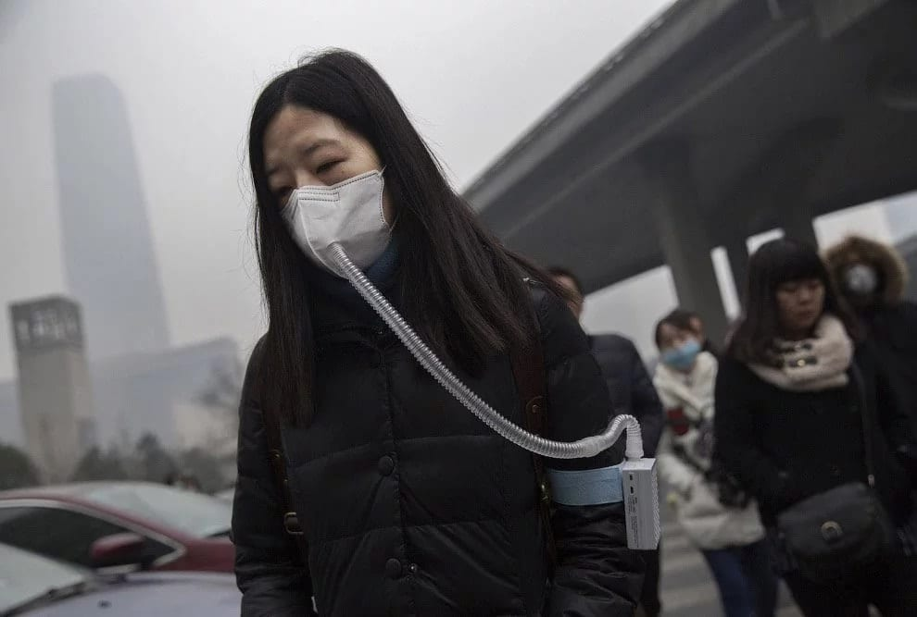
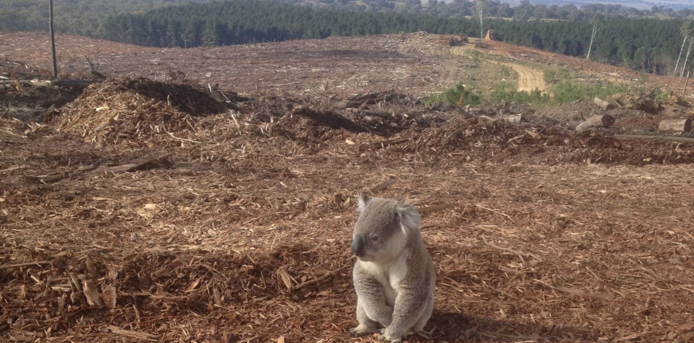

Slide 3
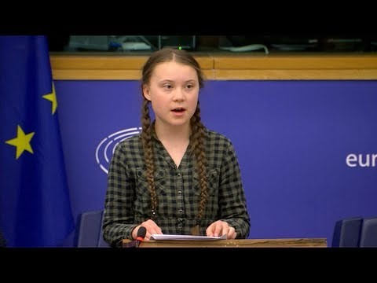

Slide 4

Get started with green Zorro, download your app!
https://greenzorro.netlify.com/

Slide 5
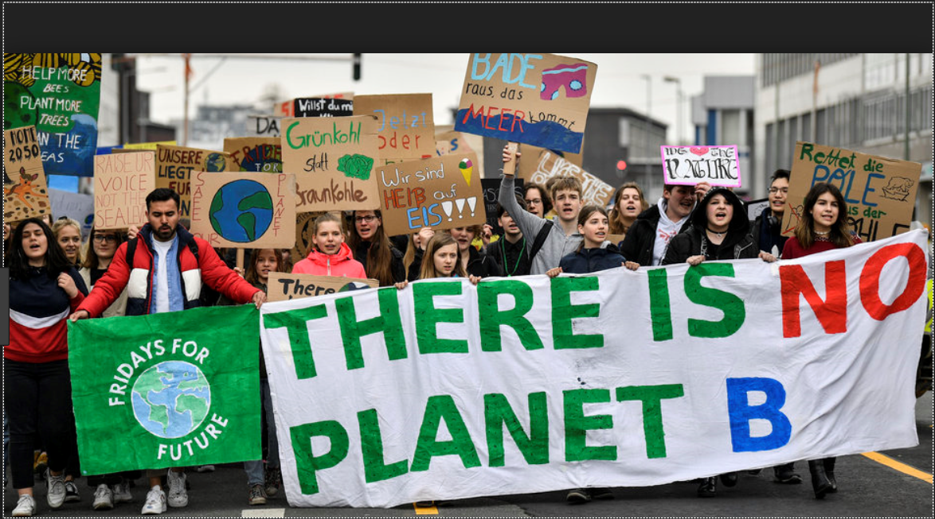
Technology by itself can not save us. We need to change our habits!

Slide 6

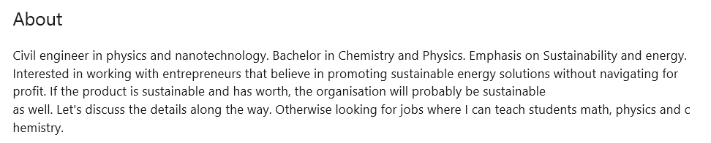
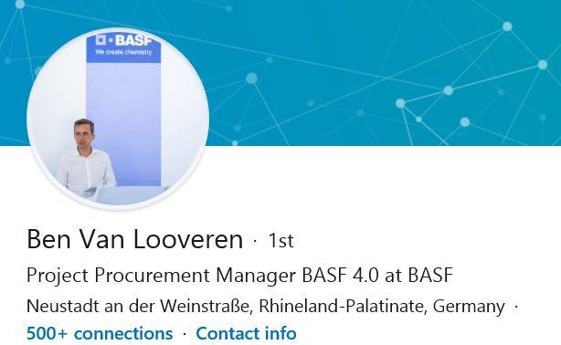

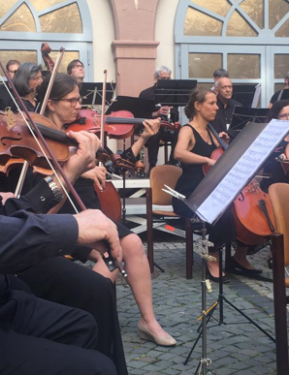
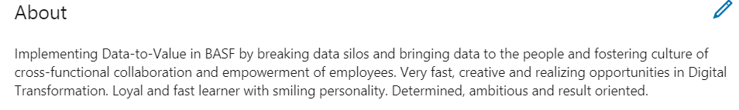
Hanna Kekkonen

Slide 7
LEVEL UP!! Green Zorro
INVEST!
Timing is perfect!
Z

